Slide 1
Median finding ‘Order Statistics and Quick SortMedian finding’ {
forbeginners.html
workshop.css
[Order Statistics and Quick Sort]
}
Programming Language

Slide 2
01
02
workshop.css
forbeginners.html
Contents Of ‘findMedian’ {
In this project, we will compare the efficiency, speed and Time Complexitybetween two algorithms.
linear-time median finding algorithm
< In the linear-time median finding algorithm, we will also compare at the time of implementation when the groups are changed so that we can know the fastest
>
randomized median finding algorithm
}
Programming Language

Slide 3
01 {
[linear-time median finding Quickselect algorithm]
forbeginners.html
workshop.css
}
Programming Language

Slide 4
Concepts < /1 > {
forbeginners.html
workshop.css
< In the beginning we made a "Wrappers to Log" so that it calculates the time of each applied algorithm and we used it with each algorithm we need to calculate its time >
}
Concepts < /2 > {
< Then we made a function of the "find the median" working with the "even-lengthed array" >
Concepts < /3 > {
< partition these elements of arr[] into groups each of odd length such that the absolute difference between the median of the groups is minimized.>
}
Programming Language

Slide 5
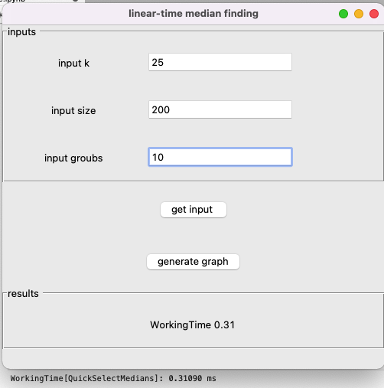
Concepts < /4 > {
forbeginners.html
workshop.css
< rt that contains the k-th smallest element. The logic is simple, if index of partitioned element is more than k, then we recur for left part. If index is same as k, we have found the k-th smallest element and we return. If index is less than k, then we recur for right part. This reduces the expected complexity from O(n log n) to O(n),>
}
Concepts < /5 > {
kthSmallest(arr[0..n-1], k)
1) Divide arr[] into ⌈n/5⌉ groups where size of each group is 5 except possibly the last group which may have less than 5 elements.
2) Sort the above created ⌈n/5⌉ groups and find median of all groups. Create an auxiliary array 'median[]' and store medians of all ⌈n/5⌉ groups in this median array. // Recursively call this method to find median of median[0..⌈n/5⌉-1]
3) medOfMed = kthSmallest(median[0..⌈n/5⌉-1], ⌈n/10⌉)
4) Partition arr[] around medOfMed and obtain its position. pos = partition(arr, n, medOfMed) 5)
If pos == k return medOfMed 6)
If pos > k return kthSmallest(arr[l..pos-1], k) 7)
If pos < k return kthSmallest(arr[pos+1..r], k-pos+l-1)
}

Slide 6
wondering; {
forbeginners.html
workshop.css
<p “But Quickselect with the median of medians pivots seemed rather complicated. Wouldn’t it be simpler to just use a random pivot?>
</p>
}
Programming Language

Slide 7
02 {
[randomized median finding algorithm]
forbeginners.html
workshop.css
}
Programming Language

Slide 8
forbeginners.html
workshop.css
Contents Of ‘findMedian’ {
Step 01
The randomization does not change what quicksort does, but it changes its performance. Quicksort runs very slowly on some inputs: its worst-case time complexity is proportional to n^2. If you are worried that the data you want to input to quicksort may hit its weak spot, randomization allows you to guarantee that this is unlikely to occur. It is then still possible that the algorithm is slow, but it is very, very unlikely to happen, regardless of which data sequence is input.
Step 02
The only difference between it and QuickSelect is that it uses an algorithm to choose a random pivot
}
Programming Language

Slide 9
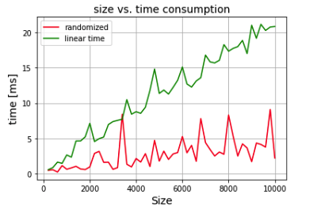
# test ‘median finding algorithms ?’ {
forbeginners.html
workshop.css
randomized
linear time
70%
40%
}
Programming Language

Slide 10
What is the difference between quicksort and quickselect? {
forbeginners.html
workshop.css
< Quickselect is a selection algorithm to find the k-th smallest element in an unordered list. The algorithm is similar to QuickSort. The difference is, instead of recurring for both sides (after finding pivot), it recurs only for the part that contains the k-th smallest element.>
}
Programming Language

Slide 11
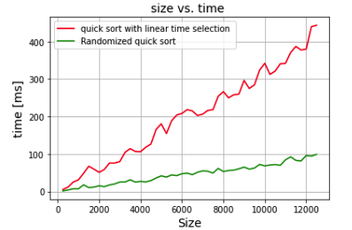
Better Quick Sort Algorithm; {
forbeginners.html
workshop.css
randomized
linear time
}
Programming Language

Slide 12
interface‘animation’ {
forbeginners.html
workshop.css
<Finally, we made a code for the interface and linked it to the Quick Sort with Linear median selection algorithms and Randomized Quick Sort. We used several sites for question and assistance, and this was the final result after linking the code to the QuickSort with the animation interface.>
}
Programming Language

Slide 13
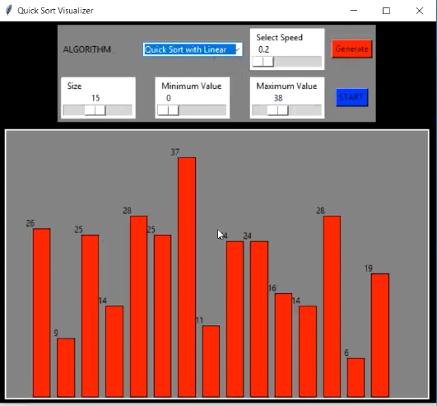
The final‘look’{
forbeginners.html
workshop.css
}
Programming Language

Slide 14











Thanks; {
forbeginners.html
workshop.css
‘Do you have any questions?’
< Please keep this slide for attribution >
}
Programming Language

Slide 15
Resources {
forbeginners.html
workshop.css
https://rcoh.me/posts/linear-time-median-finding/
https://www.geeksforgeeks.org/median-of-an-unsorted-array-in-liner-time-on/
https://towardsdatascience.com/using-wrappers-to-log-in-python-ccffe4c46b54
}
Programming Language

